Slide 1

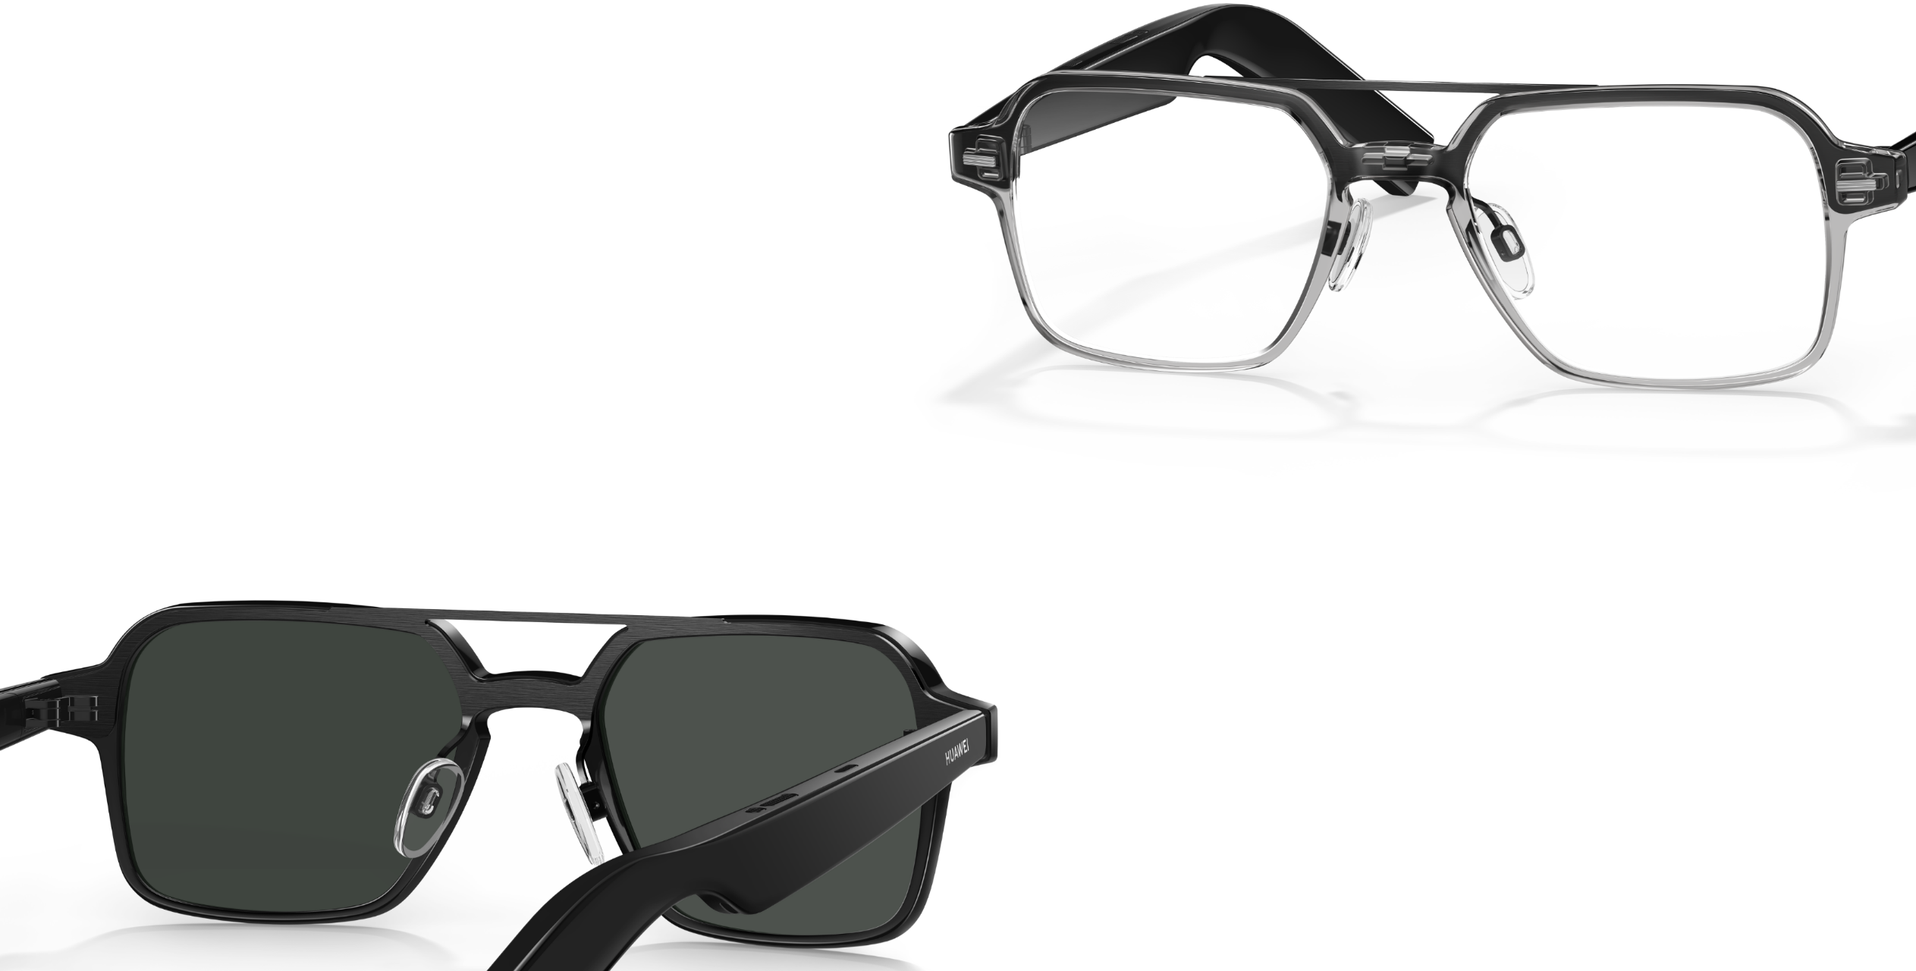

UTOGLA
SMART GLASSES
Xinyu Huang
Mengqin Wang

Slide 2
Device Connections
Normal Mode
Non-function Need
Focus Mode
Meeting Mode
CONTENT
Home Page
Drive Mode
Leisure Mode
Game Mode
Exercise Mode

Slide 3
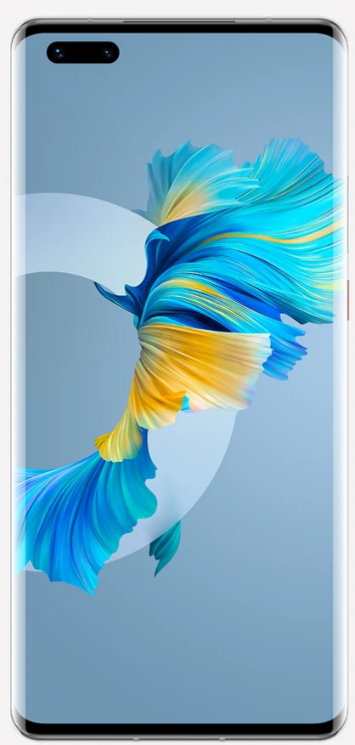
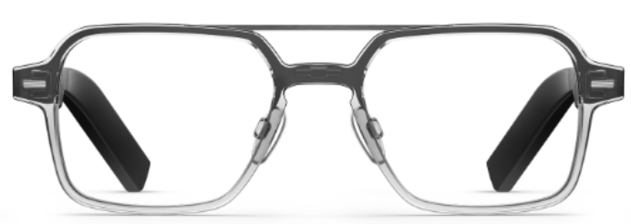
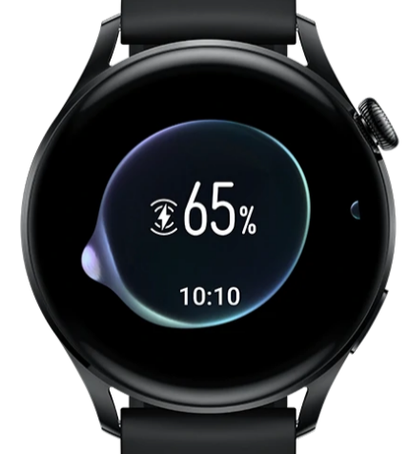
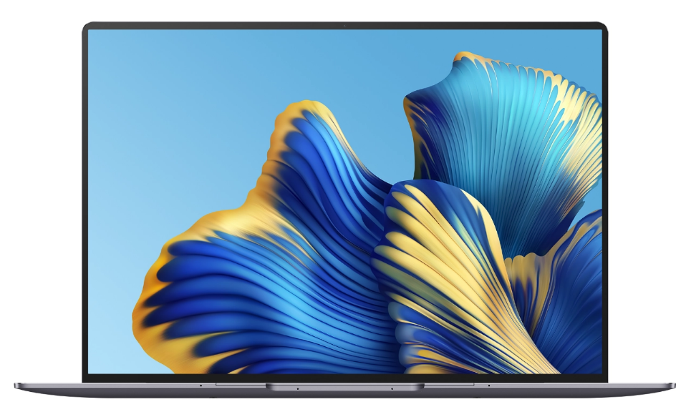
Device Connections
Glass
Watch
Laptop
Phone

Slide 4




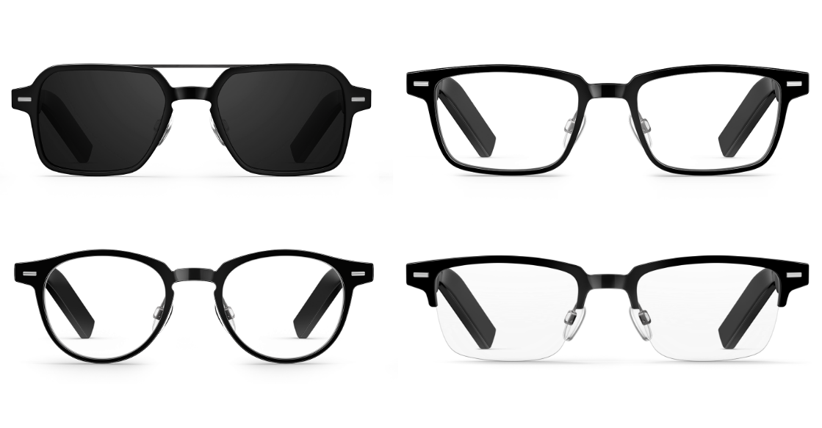
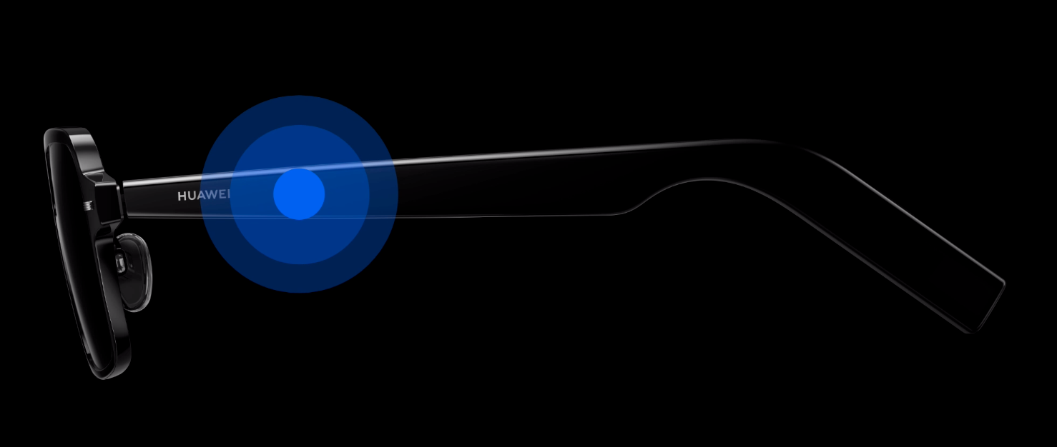


Non- Function Need
App Download
Gesture control
Voice control
Gesture control
Voice control
Reference： HUAWEI(19th of May, 2022). HUAWEI Eyewear Specifications. HUAWEI Global. https://consumer.huawei.com/en/wearables/huawei-eyewear/specs/

Slide 5
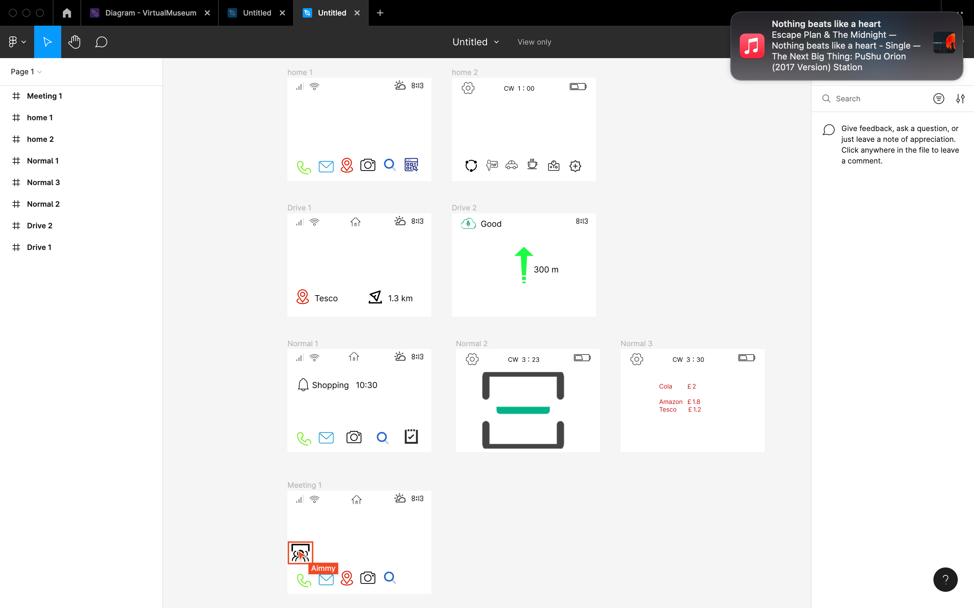

Home Page
Left Eye
Right Eye
Contact
Location
Search
Normal
Meeting
Drive
Focus
SMS
Photo
Website
Leisure
Game
Exercise

Slide 6
Normal Mode
Left Eye
Right Eye
Contact
Photo
Search
Scan the item to bring up the price of the item and compare the price with other platforms.
SMS
Website

Slide 7
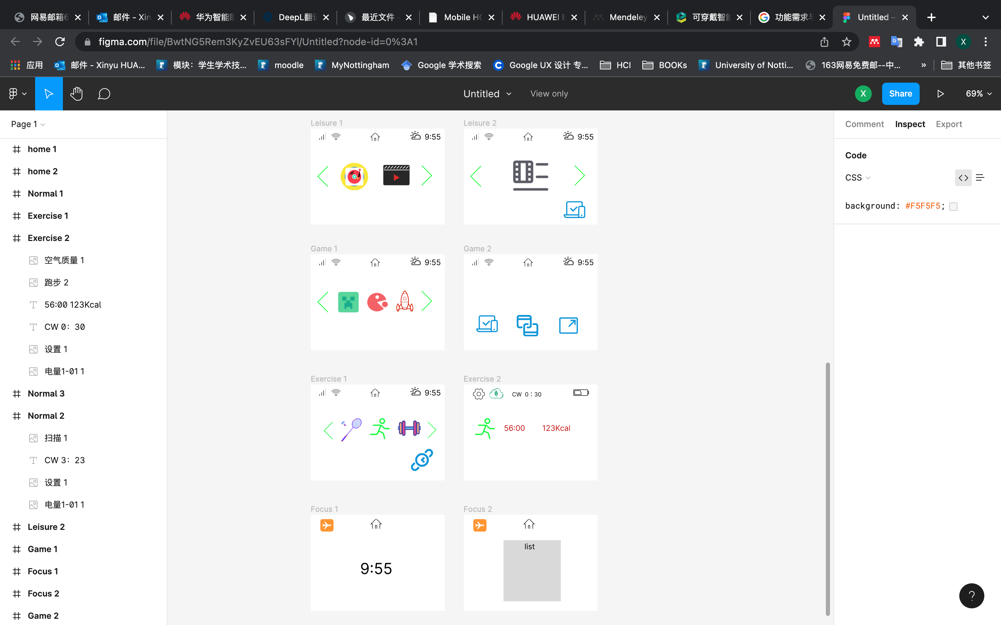
Focus Mode
Left Eye
Right Eye
Time
In focus mode the screen only shows the time and the list of surrogates, the device is silent

Slide 8
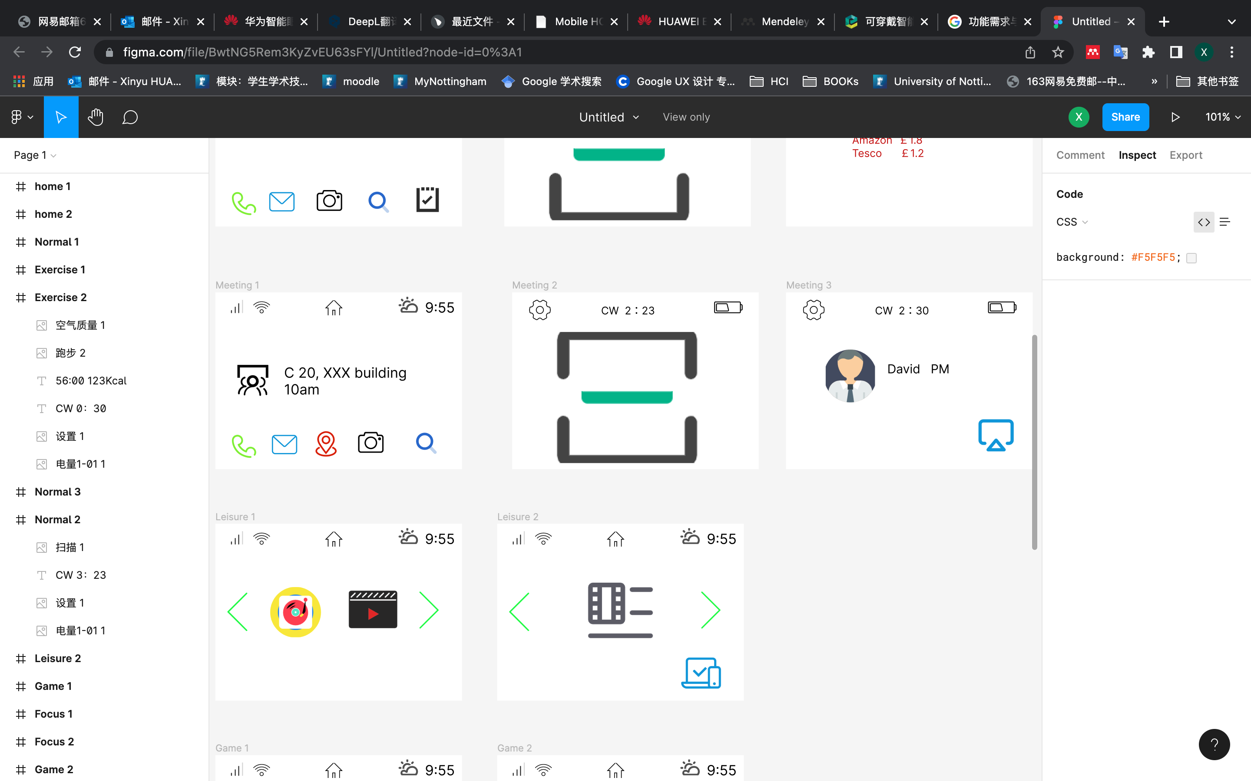
Meeting Mode
Left Eye
Right Eye
Contact
Location
Search
Meeting reminders via AI face recognition in meeting mode
SMS
Photo

Slide 9
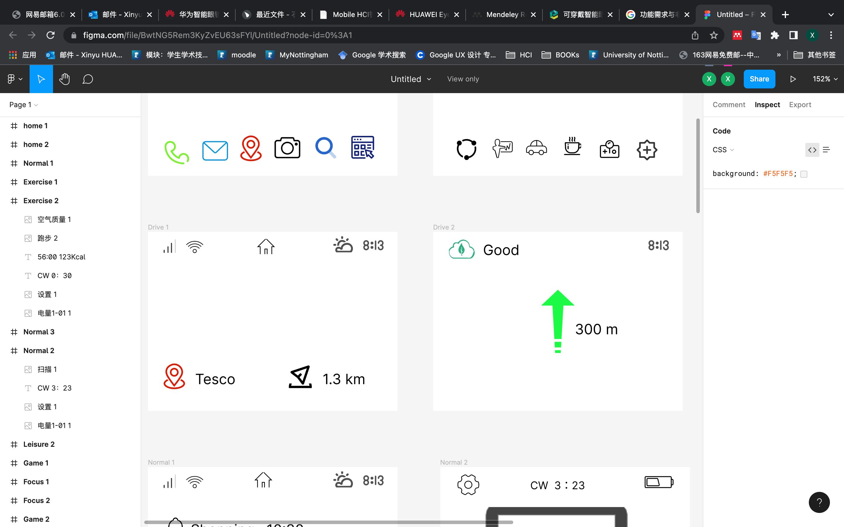
Drive Mode
Left Eye
Right Eye
Location
Distance
In Drive mode, the functions are focused on navigation.

Slide 10
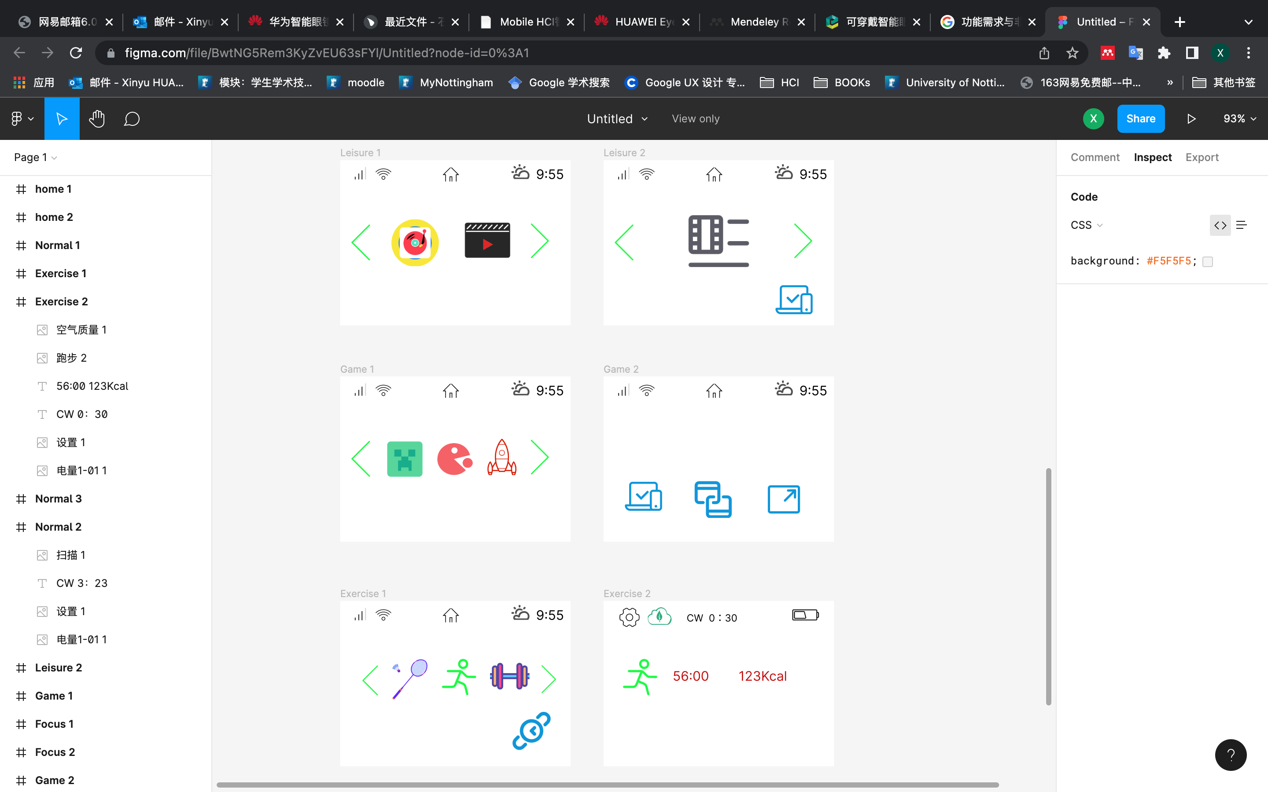
Leisure Mode
Left Eye
Right Eye
Music
Movie
Use overhead delivery to transfer the glasses interface to and from the same screen for better leisure and entertainment

Slide 11
Game Mode
Left Eye
Right Eye
Games
In Game mode, the functions are focused on playing. Users can play together.

Slide 12
Exercise Mode
Left Eye
Right Eye
Exercises
Use overhead delivery to transfer the glasses interface to and from the same screen for better exercises

